Slide 1

DIGITAL AUTOMATION CHALLENGES 2025
MOHAMAD AZAFRI BIN ABD MAJID
01
NEXT

Slide 2
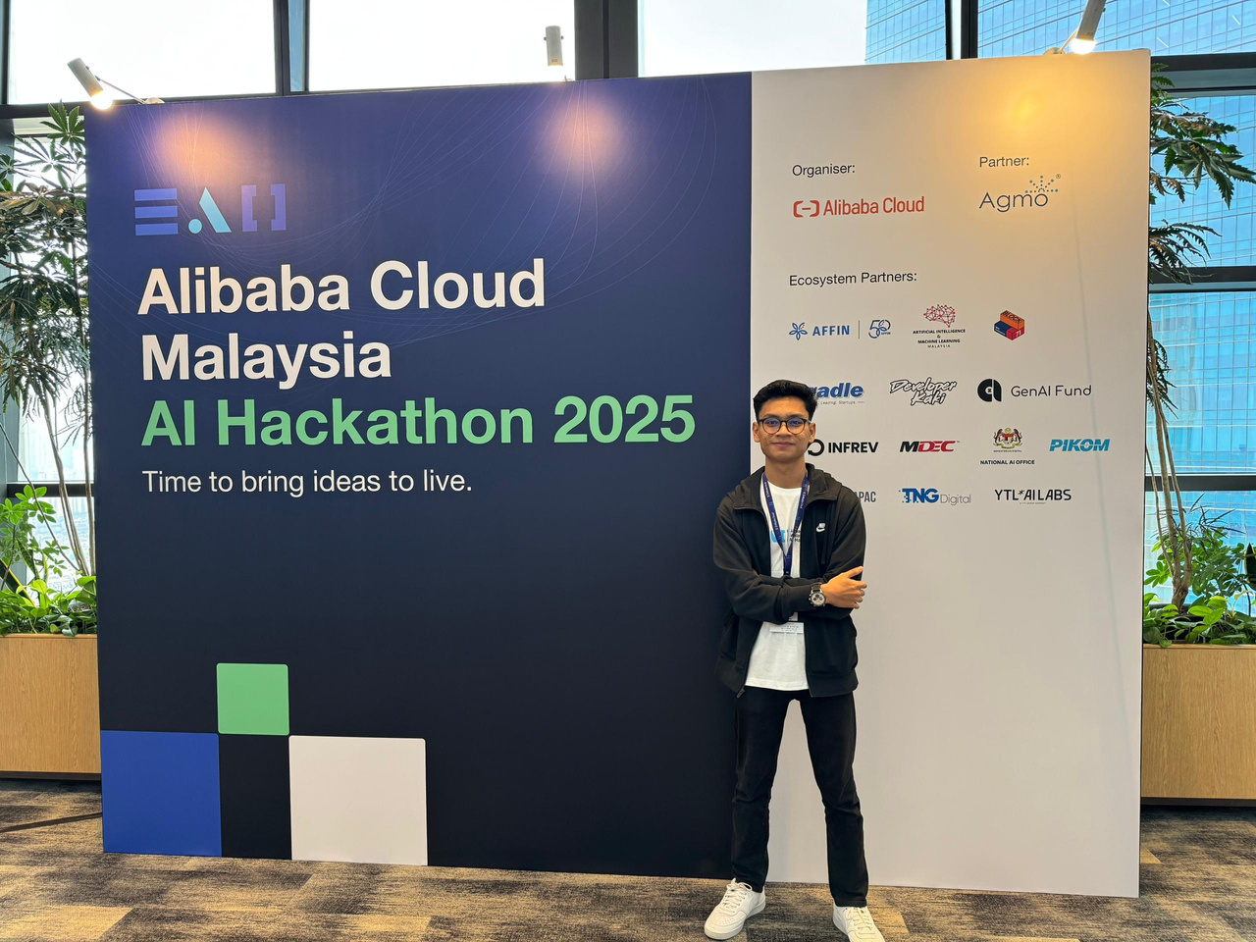
WHO AM I?
MOHAMAD AZAFRI
Software engineering
3RD YEAR
Experience in web and mobile app development

Slide 3
EXPERIENCE LEARNING UIPATH
Learned how to connect RPA with web technologies
Realized the power of end-to-end unattended automation
Improved skills in data parsing, automation logic, and system integration
Gained confidence in building scalable enterprise-grade solutions

Slide 4

NEXT
EXPERIENCE IN PARTIPICATING
Joined the challenge to solve a real-world inefficiency in form submissions.
Chose UiPath for its strength in automating repetitive, rule-based tasks.
Combined it with a Django web solution for a seamless end-user experience.

Slide 5



WHY DO I WANT TO ENROLL IN DHL INTERNSHIP PROGRAM?
Gained experience in a startup; now eager to learn how a global company operates
Interested in understanding structured workflows and enterprise-scale operations
Excited to collaborate with diverse, international teams
11
NEXT

Slide 6
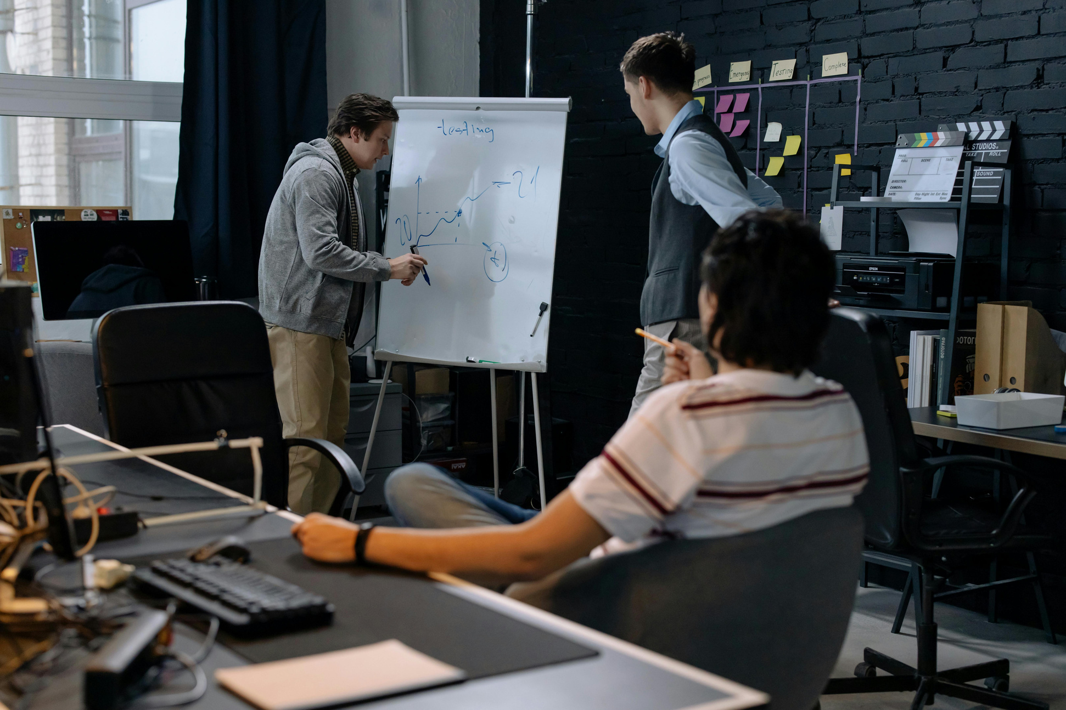
15
NEXT
THANK YOU

